Slide 1

ROLE OF NUTRITION IN SPORT 2.0
Francesco Di Martino Comaschi

Slide 2


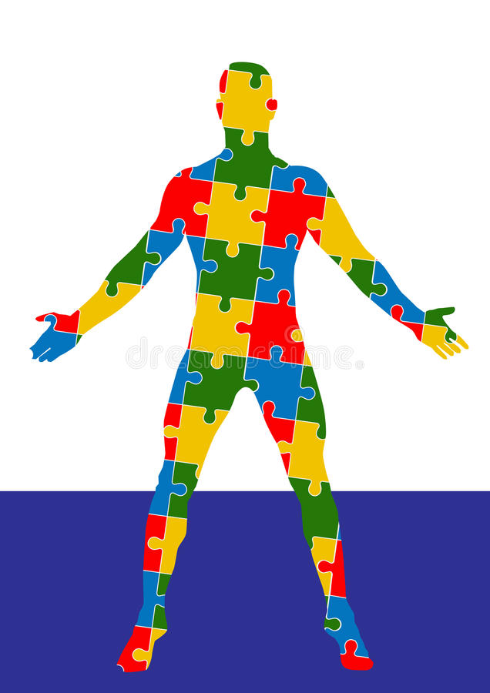


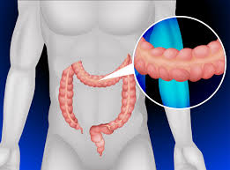
Nutritional FACTORS THAT INFLUENCE SPORT PERFORMANCEs
Carbohydrates
Energy Balance
Proteins
Minerals & Vitamins supplements
Gut
Sleep

Slide 3
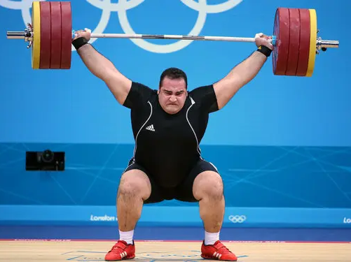
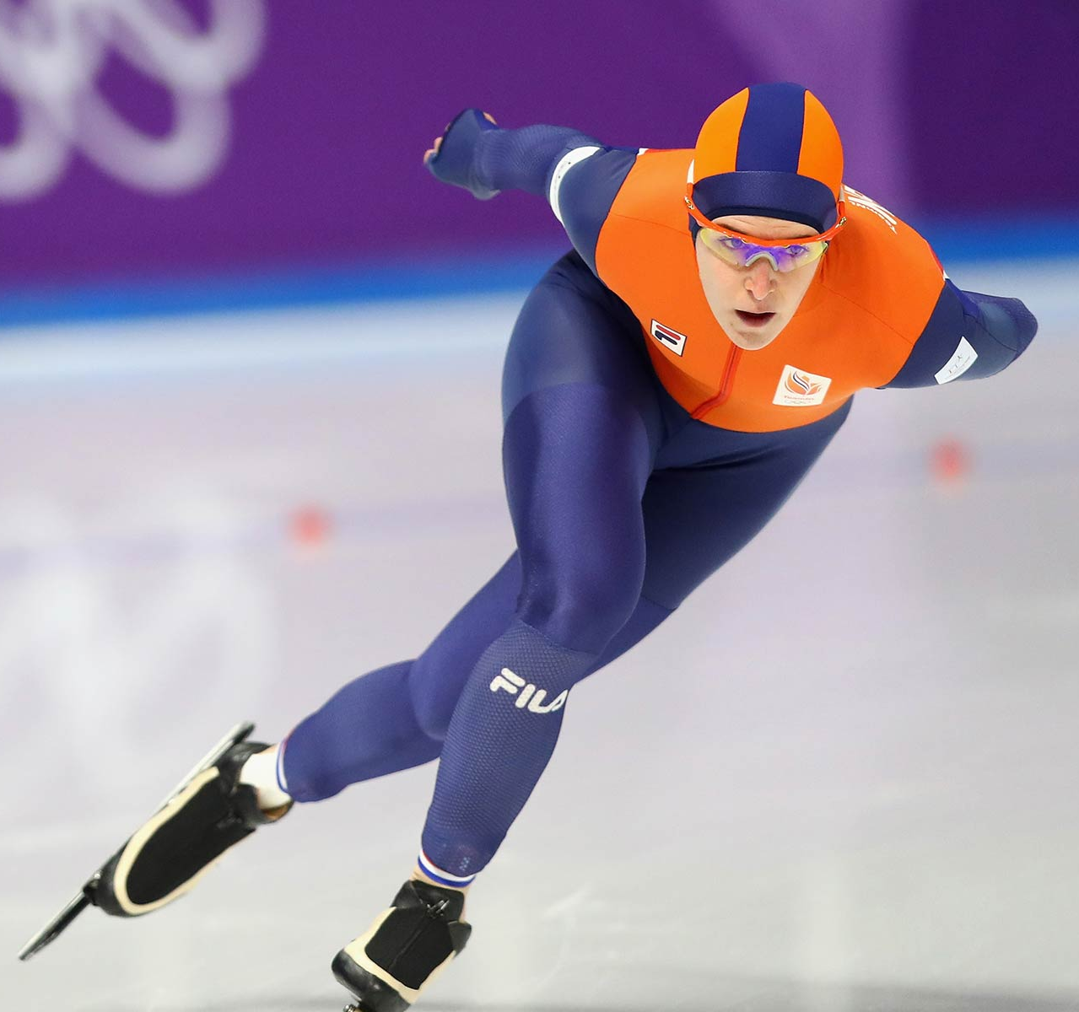
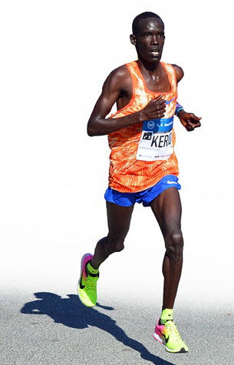
WHAT TYPE OF ATHLETE ARE YOU?
Athlete type | Duration activity and intensity | Energy source
Weight lifters, body builders and weight throwers. | Exercise duration from 2 to 5 seconds. Very high intensity bouts. | Calcium and Creatine (protein) present in our muscles (phosphagen).
Runner or skater sprinters, crossfit and skipping rope. | Exercise duration from 10 seconds to 5 minutes. High intensity bouts. | Carbohydrates in anaerobic situation, without the use of oxygen (glycolytic).
Long distance athletes as marathon runners or cyclists. | Exercise duration from 10 minutes to few hours. Low intensity bouts. | Carbohydrates and Fats in aerobic situation, with the use of oxygen (oxidative).

Slide 4
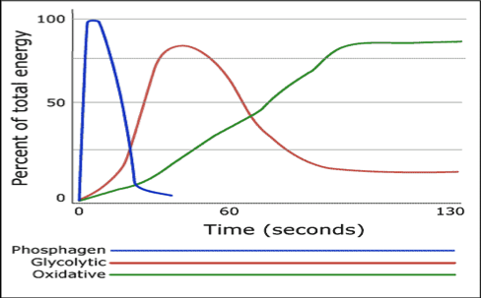
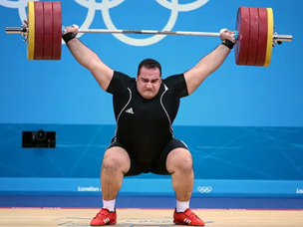
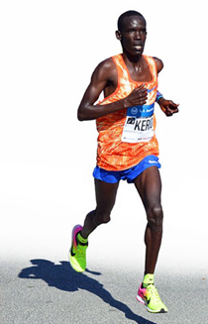
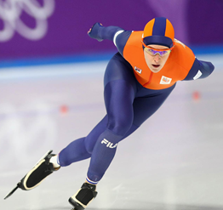

Slide 5
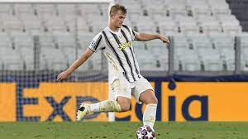
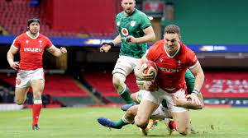
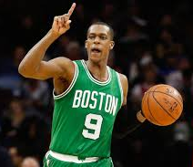
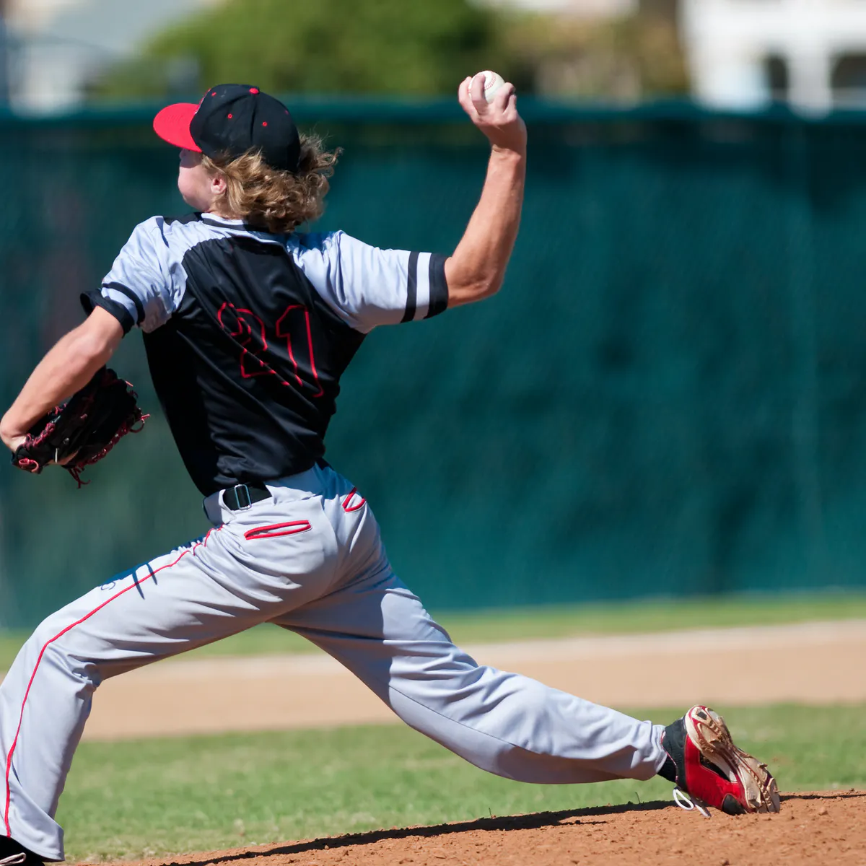
A
…AND GAME SPORT ATHLETES?
All game sport athletes use a mix of the energy sources described previously. They may change in base of sport type and the role of the athletes.

Slide 6


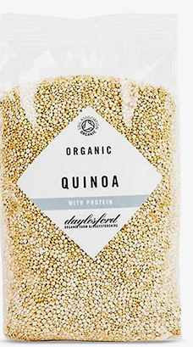
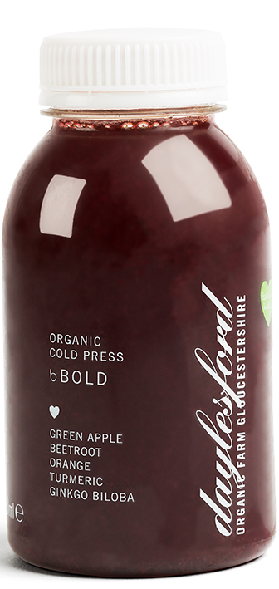

A
SOME DAYLESFORD PRODUCTS USEFULL IN SPORT

Slide 7

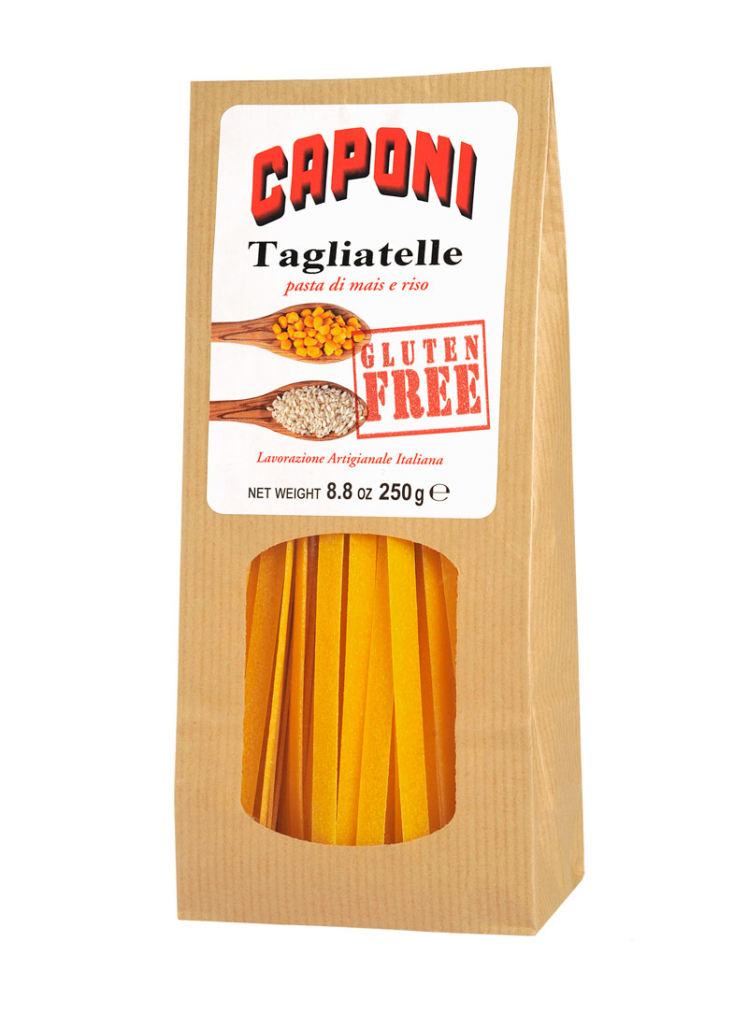
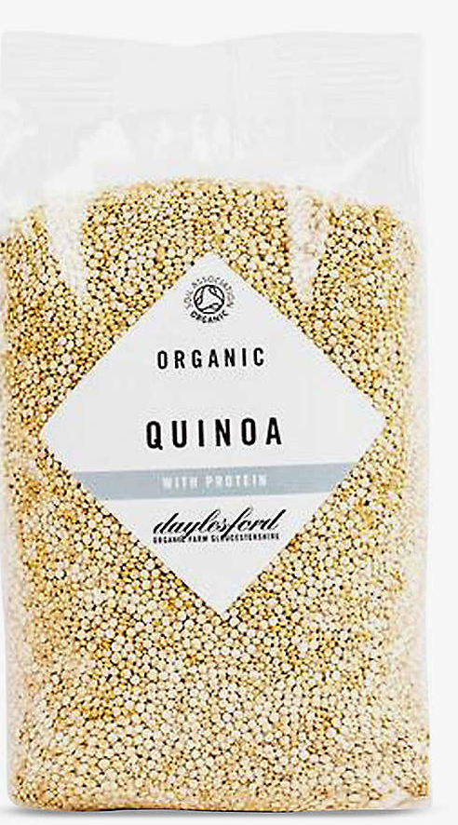
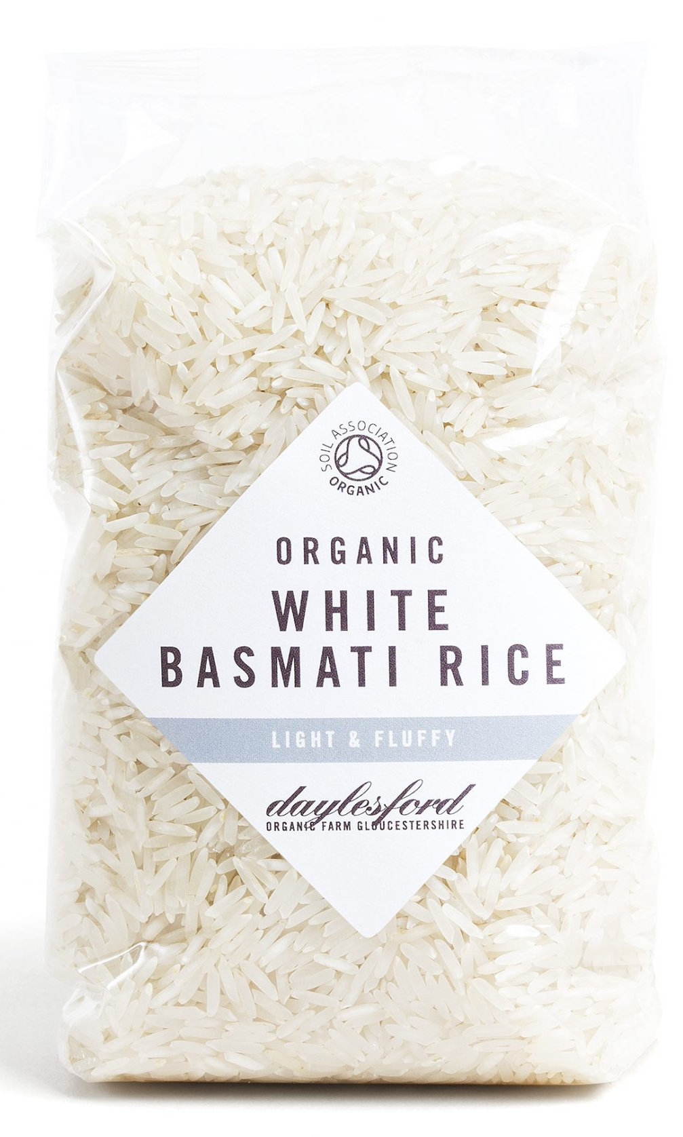
Examples of gluten-free Carbohydrates sources
Gluten is a group of seed storage proteins found in certain cereal grains. Gluten can trigger adverse inflammatory, immunological and autoimmune reactions in some people (celiac disease) or for some people could be difficult to digest it.
BENEFITS:
Easier to digest.
Low caloric.
Good source of fibers, minerals (iron, zinc, and magnesium) and protein.
The United Nations General Assembly declared 2013 as the "International Year of Quinoa“.

Slide 8
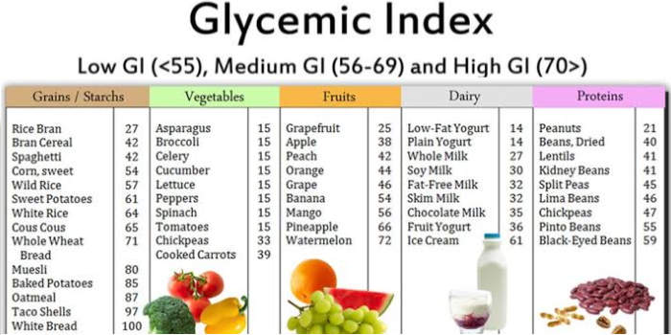
Glycemic index
Glycemia is blood glucose levels.
After a meal, our Glycemia rises while after some physical activity the Glycemia drops. Normal fasting values 60-110 mg/dL.
The Glycemic Index (GI) is a relative ranking of carbohydrate in foods according to how they affect blood glucose levels.
HIGH BLOOD GLUCOSE LEVELS:
Fat tissues synthesis.
Acidosis in our blood.
Risk of diabetes type 2.
LOW BLOOD GLUCOSE LEVELS:
Tiredness
Faint felling.

Slide 9
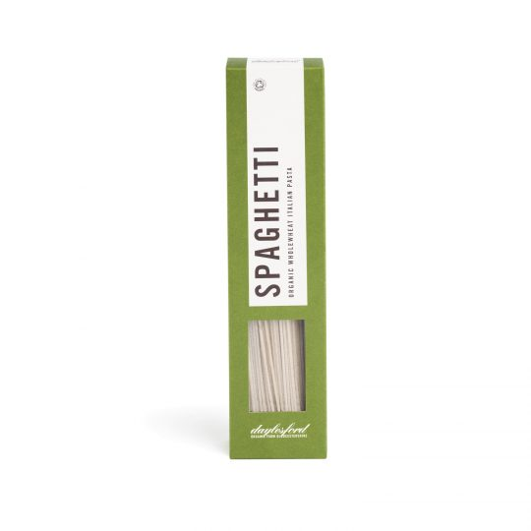
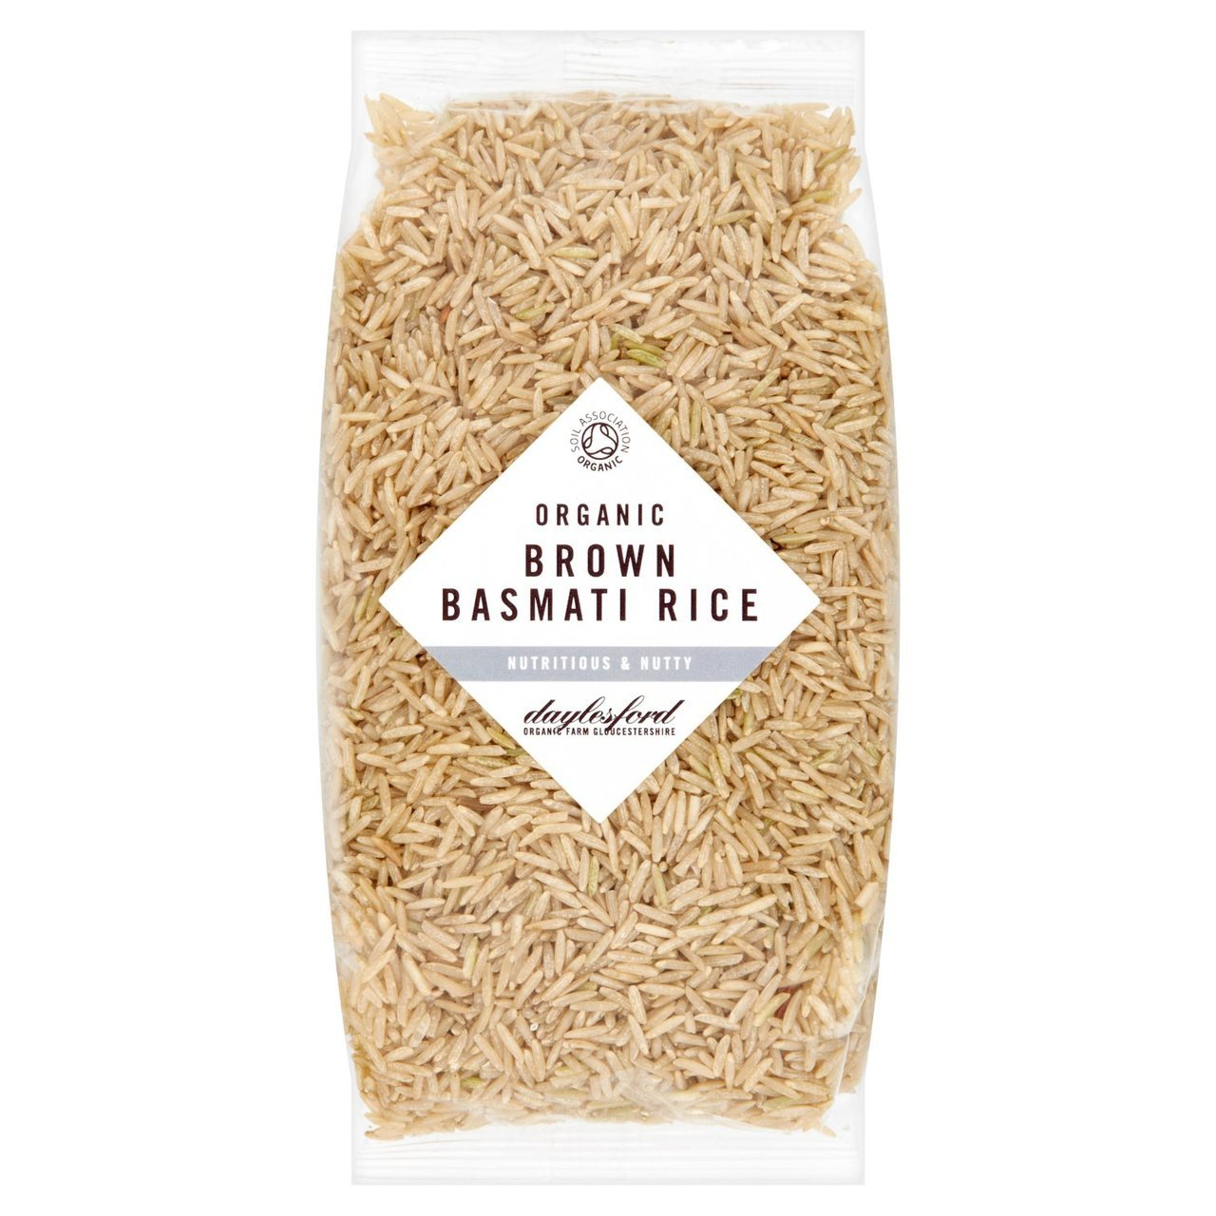
Medium and low Glycemic index CARBOYDRATE products
SUGGESTIONS TO DECREASE GI:
Wholewheat has higher fibber level that lowers G.I..
Do not overcook pasta because it realises more carbohydrates increasing GI:
Mix always with vegetables.
Eat slowly.

Slide 10
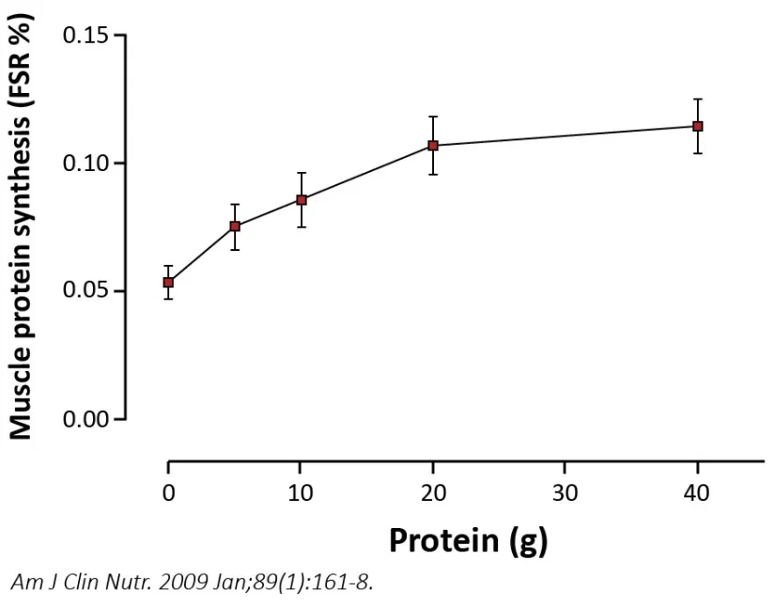
Protein's intake
Proteins are like the '' building blocks '' of our body, especially our muscles, but they can also be used as a form of energy. The ideal quantity to consume them daily is linked to the body weight of a single individual and his physical activity; the higher they are, the higher the need for protein.
Sedentary people 0,8 g per kg/day.
Athletes 1,2-1,4g per kg/day.
Professional Athletes 1,6-1,7 g per kg/day.
The optimal protein amount in a meal or in a pre-workout snack is about 20-25 grams. Higher intakes do not give extra benefits, but some cases may cause adverse effects.

Slide 11
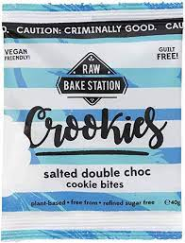
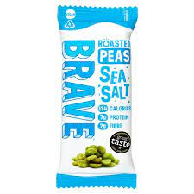
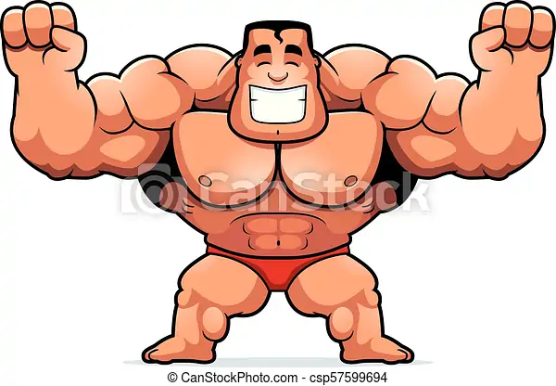
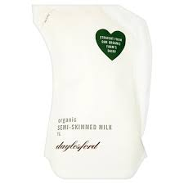
Ideas of post-workout snacks

Slide 12
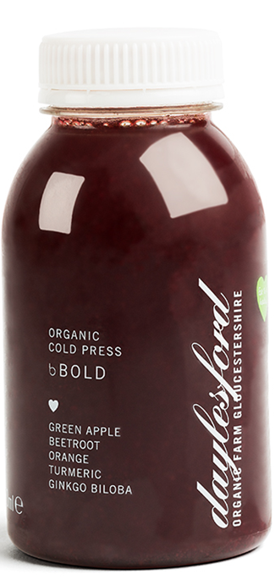
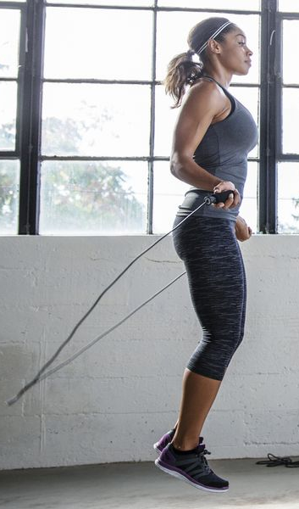
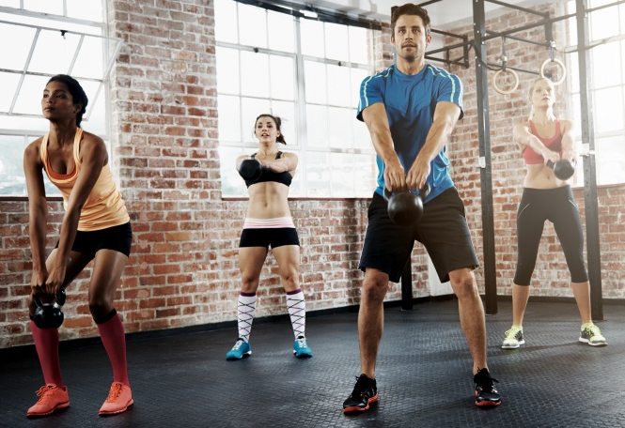
Beetroot juice
BENEFITS:
Increase blood flow and oxygen exchange.
In the energy release and its efficiencies.
Strengthening of muscle contraction.
Suitable for short and high intensive workouts as crossfit or skipping rope.

Slide 13
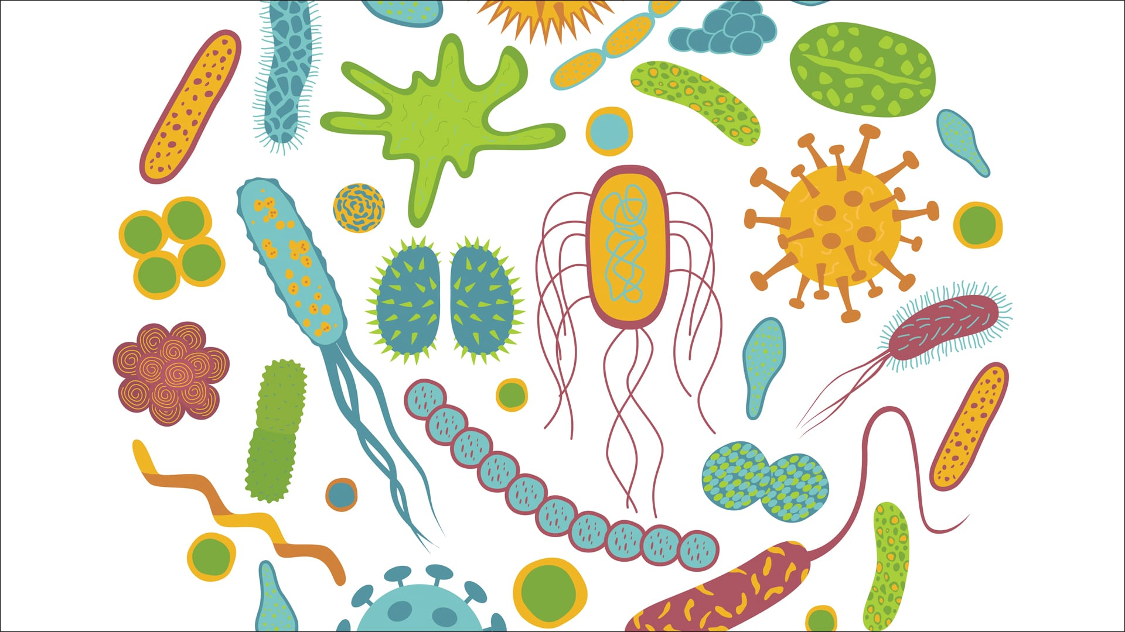
Gut microbiome
The gut microbiome consists of the collective genome of microbes inhabiting the gut (symbiotic and pathogenic) including bacteria, archaea, viruses, and fungi.
Control digestion.
Benefits in the immune system
May contribute to prevent weight gain, high blood sugar, high cholesterol and other disorders.
Protects pathogen bacteria.
Synthesis of K group vitamins.
“There are more bacteria than cells in our body.” .

Slide 14

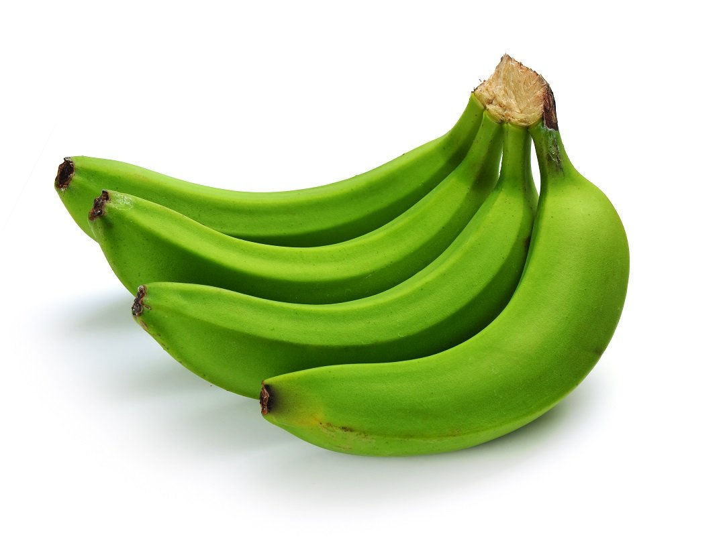
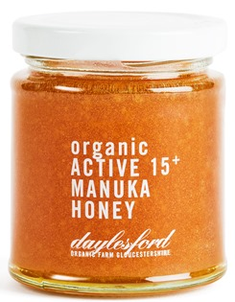


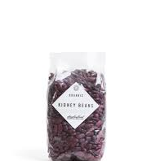
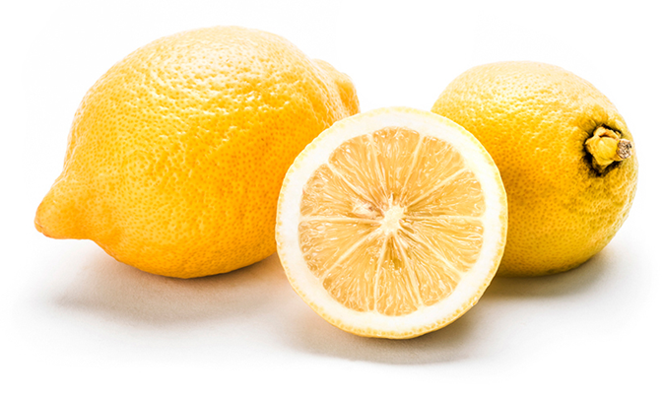
prebiotic vs Probiotic
PREBIOTIC are compounds in food that induce the growth or activity of beneficial microorganisms. THEY DO NOT CONTAIN MICRORGANISMS.
PROBIOTIC are foods that contain live microorganisms, used to improving or restoring the gut flora.

Slide 15
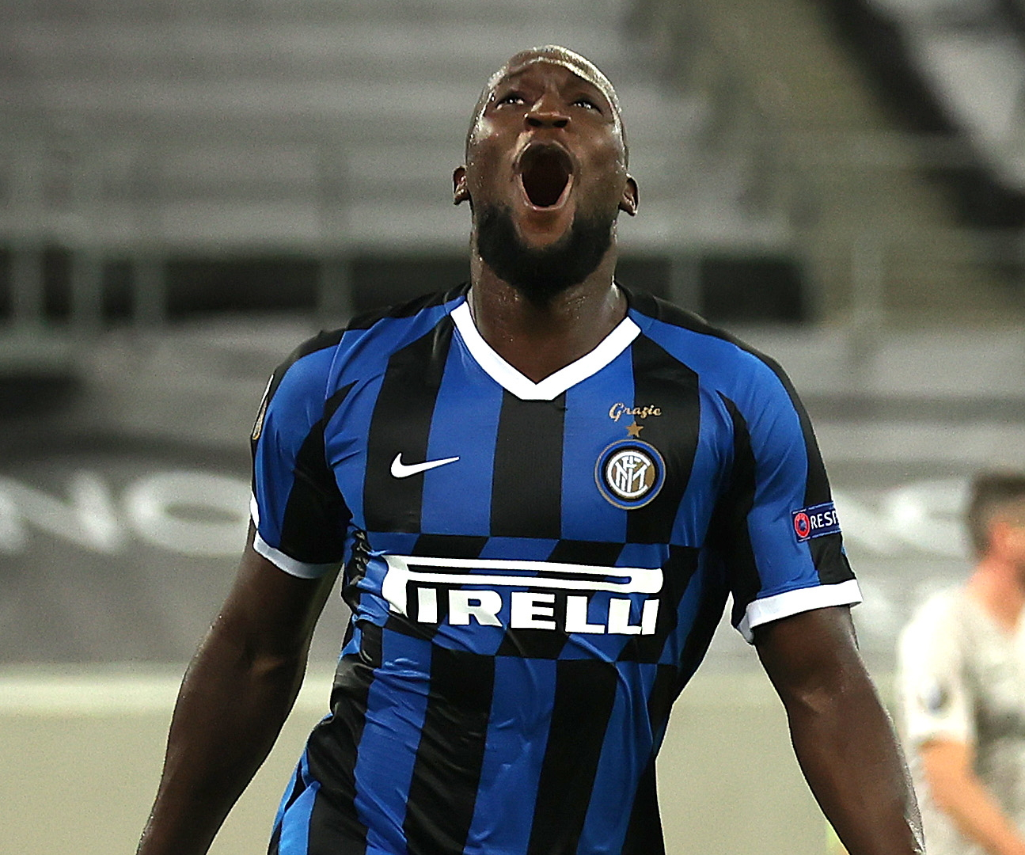
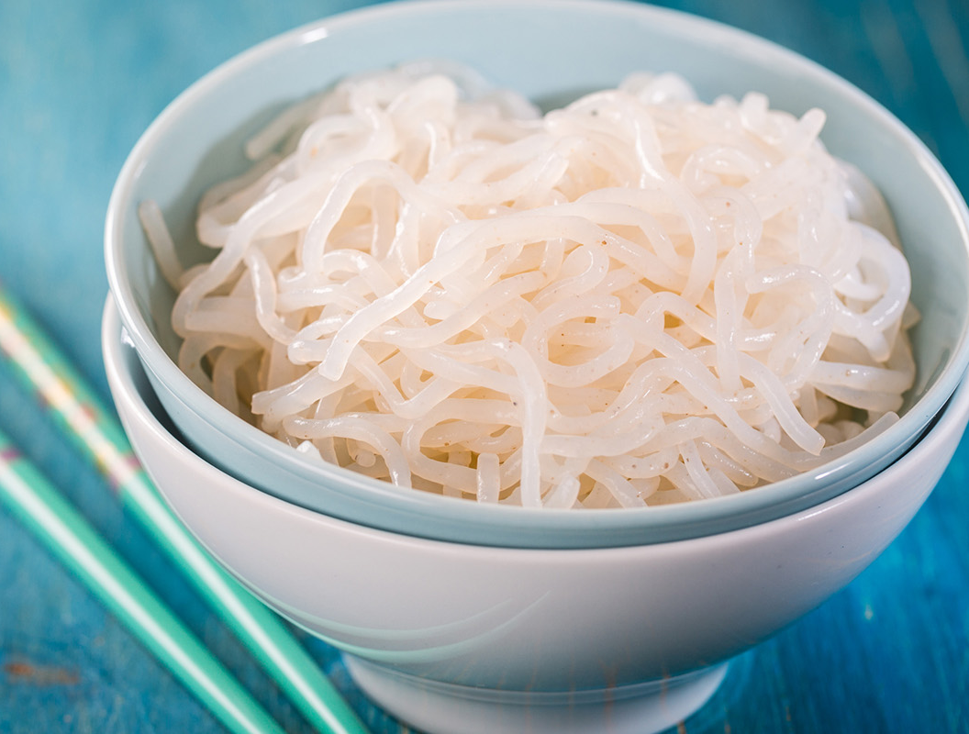
Ideas for future products
SHIRATAKI PASTA
In an interview former Manchester United and Chelsea striker, Romelu Lukaku admitted he found his best physical shape in Italy when he was followed by a nutritionist. In the interview mentioned the Shirataki pasta.
Shirataki are translucent, gelatinous traditional Japanese noodles made from the konjac yam. Easy to digest, low calories, low G.I. and facilitates intestinal transit.

Slide 16
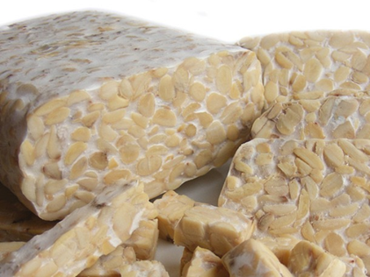

tempeh
Product of Indonesian origin that comes from the fermentation of soy.
The fermentation process and subsequently the cooking allows a high digestibility compared to other soy products.
100 g of Tempeh provide about 166 kcal, contain 20.7 g of protein, 6.4 g of lipids, 6.4 g of carbohydrates and 4.1 g of fiber.
Excellent to eat with grilled vegetables, sweet and sour sauce or to put in risotto.

Slide 17

T
Thank you for your attention

